Slide 1


Social Trend
For Social Buzz

Slide 2


Today's agenda
Project recap
Problem
The Analytics team
Process
Insights
Summary

Slide 3


Social Buzz is a rapidly developing technology that demands speedy global adaptation. Accenture has started a three-month POC with a focus on these tasks:
A review of social Buzz's big data methodologies.
Recommendations for a successful IPO.
Study to identify the top 5 content categories on social Buzz.
Project Recap

Slide 4


Problem
Daily postings of over 100,000.
36.5 million pieces of content annually!
But with so much available, how can you thrive from it?
Analysis to find social Buzz’s top 5 most popular categories of content?

Slide 5



Ogbuzuru Kelechi
Data Analyst
The Analytics Team
Marcus Rompton
Senior Principle
Andrew Fleming
Chief Technical Architect

Slide 6

Process
1
Data Understanding
2
Data Cleaning
3
Data Modeling
4
Data Analysis
5
Discover insights

Slide 7
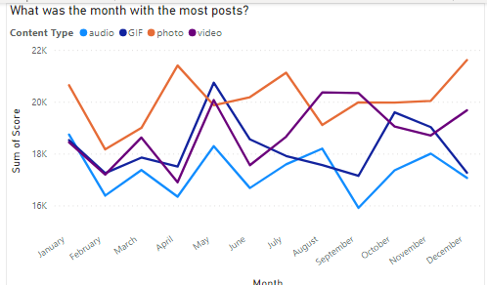


Insights
Notes:
﻿Photo had the highest total Sum of Score at 241090, followed by video, GIF, and audio.﻿﻿ ﻿﻿ ﻿﻿December in Content Type made up 2.42% of Sum of Score.﻿﻿ ﻿﻿ ﻿
photo had the highest average Sum of Score at 20,090.83, followed by video, GIF, and audio.

Slide 8
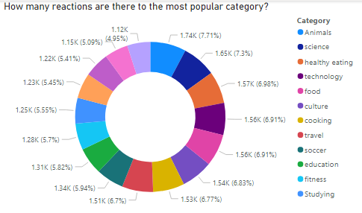
Notes:
﻿﻿Animals accounted for 7.71% of Count of Reaction Type.﻿﻿ ﻿﻿ ﻿

Slide 9
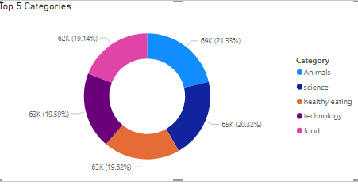
Notes:
Animals accounted for 21.33% of Sum of Score.﻿﻿

Slide 10
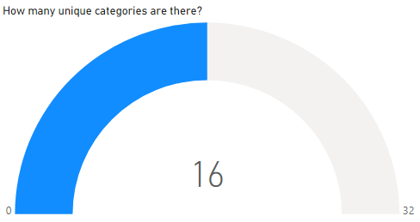

Slide 11


The category with the most reactions is Animals and Science. It demonstrates that the public prefers content in these categories.
Recommendation
In order to create content for these categories, additional resources and research need be used.
Since it has the lowest score in the months trend, social buzz should consider boosting the items related to gifs and audios.
Summary

Slide 12

Thank you!
ANY QUESTIONS?

